Slide 1
BPMN to represent the mobilization of Computable Biomedical Knowledge (CBK)
&
Data Story using Tableau
Team Student IDs:
UP2301022
UP2301025
Masters in Artificial Intelligence & Machine Learning (MSc AI&ML)
Part Time, 2024-2025
M33878 BUSINESS INTELLIGENCE (BI) Coursework Item 2

Slide 2
Task 1
Explore the key principles, mechanisms of activity, and the vision of CBK to develop BPMN diagrams that depict processes fostering the open and FAIR CBK ecosystem.
&
Create Business Process Model and Notation (BPMN) diagrams to represent the mobilization of Computable Biomedical Knowledge (CBK) as outlined in the manifesto
Refer Link (Artifacts):
https://github.com/ranjankumar03/Master-of-Science-MS---Artificial-Intelligence-and-Machine-Learning/blob/main/TERM%20IV/COURSEWORK/Part_2/

Slide 3
Understanding the CBK Manifesto
According to the Mobilize CBK Manifesto, the key elements
for mobilizing CBK include:
FAIR principles (Findable, Accessible, Interoperable, Reusable)
Open knowledge sharing
Stakeholder collaboration
Trust and transparency in decision-making
Continuous improvement in knowledge artifacts

Slide 4
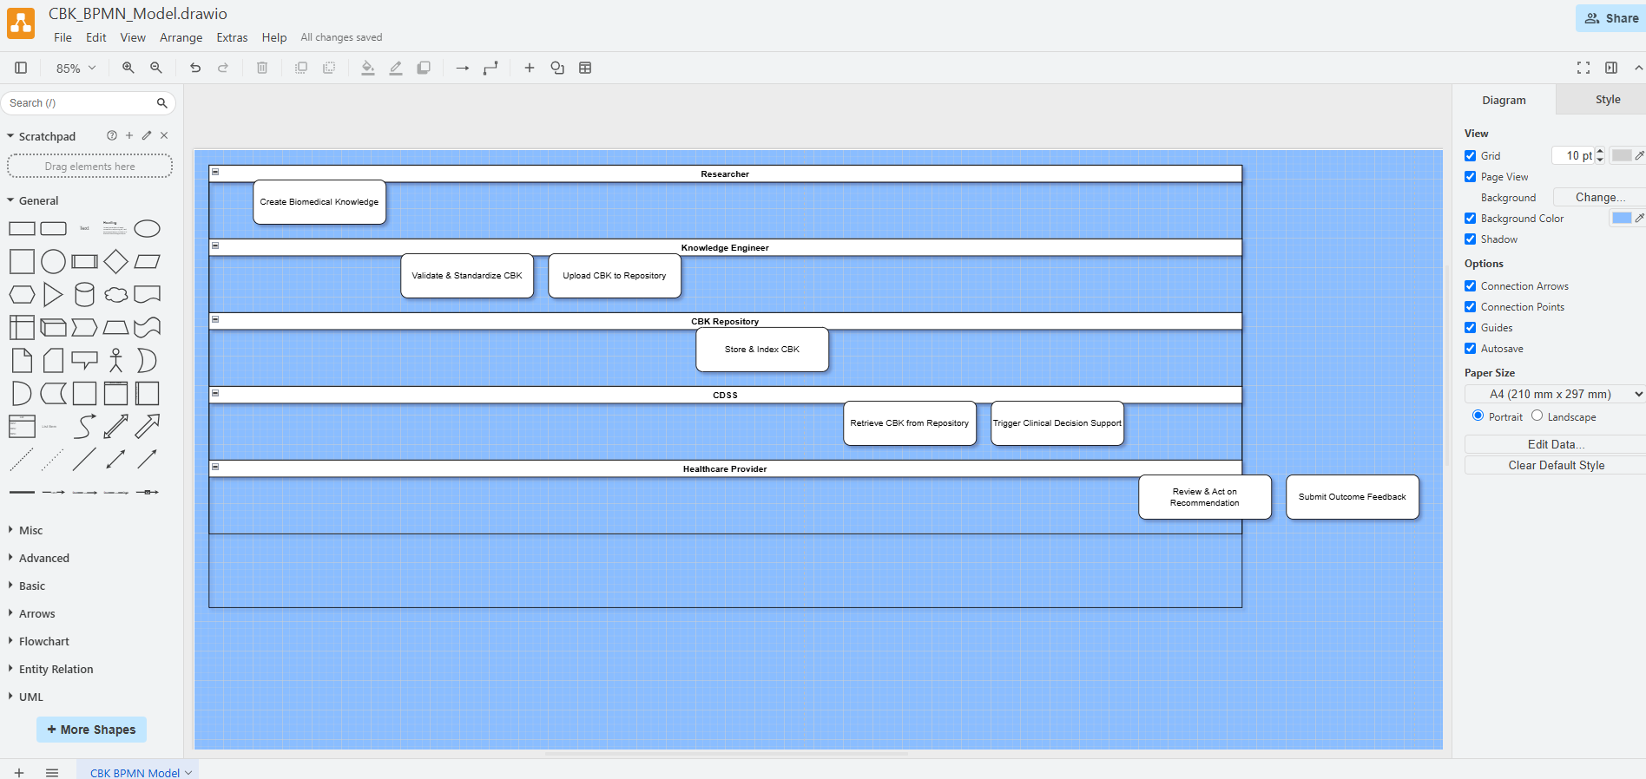
BPMN Design – Comprehensive CBK Mobilization Model This BPMN diagram simulates the mobilization of CBK in a healthcare setting, showing how knowledge is created, validated, shared, and applied to improve care delivery. The process is visualized in a horizontal pool with five swimlanes, each representing a different stakeholder or system involved.
Go to - https://app.diagrams.net

Slide 5
Swim-lanes (Actors/Roles)
Lane | Role in CBK Workflow
Researcher | Generates raw biomedical knowledge (e.g., from clinical research or literature).
Knowledge Engineer | Standardizes and encodes this knowledge into computable forms (e.g., CPGs, algorithms).
CBK Repository | Stores and indexes validated CBK, ensuring accessibility and interoperability.
CDSS (Clinical Decision Support System) | Retrieves and uses CBK to generate clinical insights in real-time.
Healthcare Provider | Uses decision support recommendations and provides feedback on effectiveness.

Slide 6
Process Flow(Key Tasks)
Each step in the BPMN diagram represents a task in the CBK mobilization cycle.
1. Create Biomedical Knowledge
Actor: Researcher
Description: Raw biomedical insights are generated through studies, trials, or clinical practice data.
2. Validate & Standardize CBK
Actor: Knowledge Engineer
Description: Ensures the knowledge complies with open standards (e.g., HL7, FHIR), is machine-readable, and fits into the FAIR
framework (Findable, Accessible, Interoperable, Reusable).
3. Upload CBK to Repository
Actor: Knowledge Engineer
Description: The knowledge is submitted to a shared repository for future retrieval and use.
4. Store & Index CBK
Actor: CBK Repository
Description: The CBK is catalogued and indexed using metadata to make it findable and accessible.
5. Retrieve CBK from Repository
Actor: CDSS
Description: Clinical systems query and fetch appropriate CBK resources when needed.
6. Trigger Clinical Decision Support
Actor: CDSS
Description: CDSS uses CBK to evaluate patient data and deliver alerts, recommendations, or predictions to the clinician.
7. Review & Act on Recommendation
Actor: Healthcare Provider
Description: Clinicians interpret and apply CDSS insights into care decisions (e.g., medication, diagnosis, risk management).
8. Submit Outcome Feedback
Actor: Healthcare Provider
Description: Clinical outcomes and user feedback are looped back for continuous learning and CBK improvement.

Slide 7
Use Case
A primary care physician diagnosing early-stage diabetes receives a recommendation from the
CDSS for a medication plan based on the latest computable guidelines and patient history.
Focus Area: CBK in Clinical Decision Support (CDS)
This sub-process zeroes in on how CBK is used in a real-time clinical setting to improve patient
outcomes.
Steps:
Trigger Event -> A clinician inputs patient data into the EHR.
CDSS Action -> System queries CBK repository using metadata and context (e.g., age, symptoms, conditions).
Retrieve and Interpret -> CDSS fetches relevant CBK and evaluates it against rules.
Provide Recommendation -> A treatment or diagnostic suggestion is displayed.
Clinician Decision -> Accepts, modifies, or rejects recommendation.
Action Taken -> Patient receives care.
Outcome Recorded -> Outcome and clinician feedback loop back into repository for CBK refinement.
Impact on Healthcare
Enhances Evidence-Based Practice: Real-time access to up-to-date medical knowledge.
Improves Patient Safety: Reduces errors by guiding decisions with validated knowledge.
Accelerates Learning Health Systems: Feedback-driven improvement loop.
Promotes Interoperability: Systems communicate via standard CBK formats and metadata

Slide 8
Task 2 : Data Story
The Tableau file for Task 2 is available at: https://github.com/VishnuMurali08/Automation-Risk-Across-U.S.-Jobs
📂 File to open: BI_CW2_DataStory.twb

Slide 9
Introduction & Motivation
Title: Why Examine Automation Risk in the Workforce?
Content:
Automation technologies are increasingly replacing routine, predictable job tasks across many sectors.
This project explores who is most vulnerable to these changes, by state, education level, income and occupation.
Key Questions:
Which U.S. states have the most jobs at risk of automation?
How do wages and educational background relate to job automation risk?
Which occupations are expanding or declining as automation advances?
Relevance: Findings can guide policy, workforce training, and education reform in the face of rapid technological change.
Notes:
OECD – Organisation for Economic Co-operation and Development
An international organization of 38 countries (mostly developed) that promotes policies to improve economic and social well-being.
BLS → U.S. Bureau of Labor Statistics

Slide 10
Dataset 1: Automation Data by State
Source: Frey & Osborne (2017), adapted via U.S. labor statistics
Combined and cleaned by AndrewMVD (Kaggle, 2020) → Click for the link
Variables: SOC code, Occupation, Probability of Automation, Employment by StateSample: 700+ occupations across all 50 states
Note: Based on predicted automation likelihood from task-based modeling
Dataset 2: Occupational Projections
Source: U.S. Bureau of Labor Statistics (2023 release) → Click for the link
Variables: Employment 2023-2033 % change, Education Required, Median Wage
Sample: 30+ occupation groups
Note: Official projections based on industry and economic trends
Dataset 3: Standard Occupational Classification (SOC) Codes
Source: U.S. Bureau of Labor Statistics →SOC User Guide → Click for the link
Details: Includes a structured classification of U.S. occupations grouped by industry and functional roles.
Variables: SOC Code, Occupational Group Category (e.g., Healthcare, Management, Legal, etc.)
Structure: Two-digit SOC codes representing 23 major occupational groups.
Purpose: Helps standardize job classifications across datasets, enabling comparison and categorization in analysis.

Slide 11
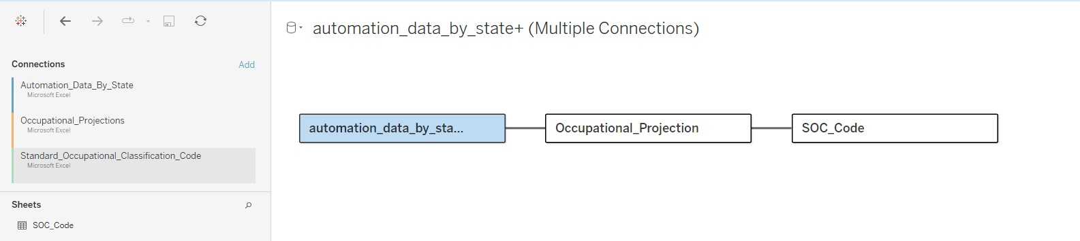
Combining Data Sources in Tableau
To analyze automation risk effectively, we combined three separate Excel datasets using Tableau’s data model feature.
Datasets Used:
Automation_Data_By_State →Includes job risk levels across states by SOC codes
Occupational_Projections → Contains 2023 job growth, wage, and employment estimates
SOC_Code → Provides job category names and definitions based on standardized SOC codes
Join Logic:
The first join connects automation_data_by_state with Occupational_Projection by matching:
SOC (from Automation data)
to 2023 National Employment Matrix code (from Projections)
The second join links Occupational_Projection to SOC_Code using:
SOC Prefix = SOC Code
These joins allowed us to blend automation risk, employment forecasts, and job descriptions, enabling deeper visual analysis of trends across states, education levels, and job types.

Slide 12
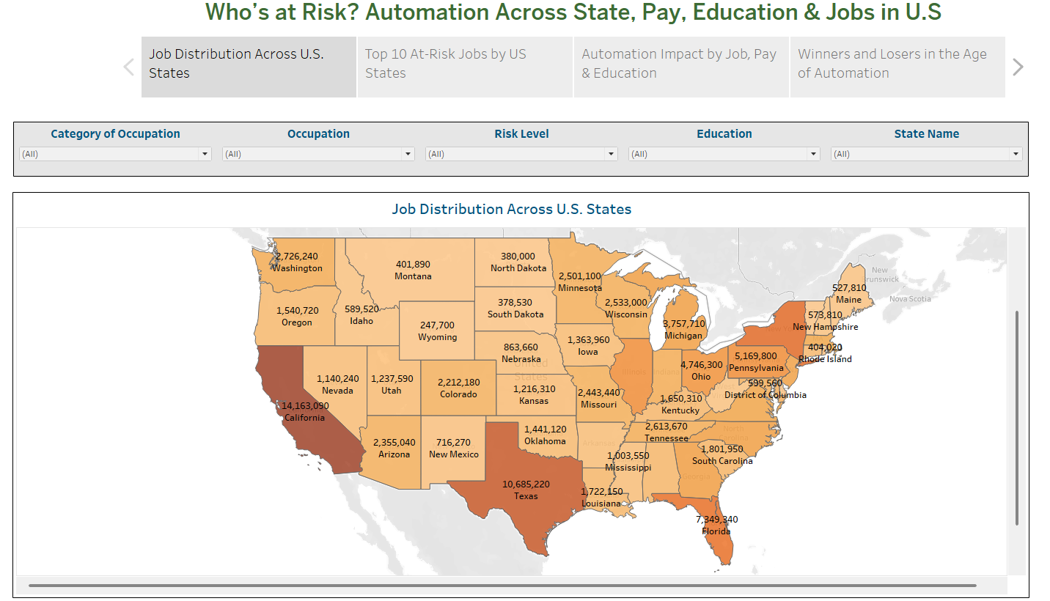
Job Distribution Across U.S. States
This map shows total job counts across U.S. states, with darker states having more jobs.
California and Texas lead, each with over 10 million jobs.
States like Wyoming and North Dakota have fewer jobs.
Purpose: Identifying high-employment areas for strategic workforce planning.

Slide 13
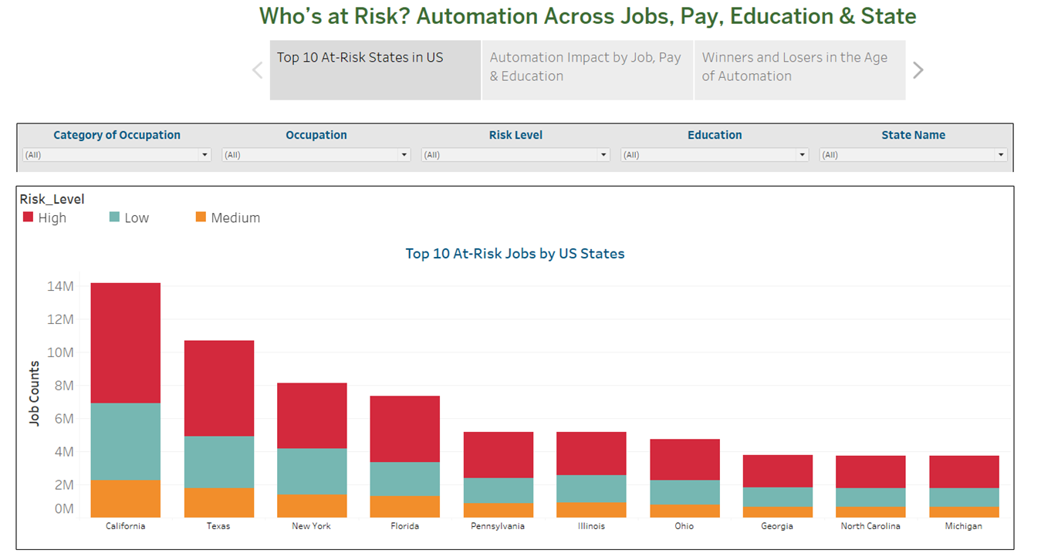
Top 10 U.S. States with High Automation Exposure
States like California, Texas, and New York have the highest job volumes at risk.
California shows over 14 million roles, with a significant share in high-risk categories.
While large population states dominate in total numbers, automation disproportionately affects certain local economies.
The chart reflects both job density and economic vulnerability at the state level.

Slide 14
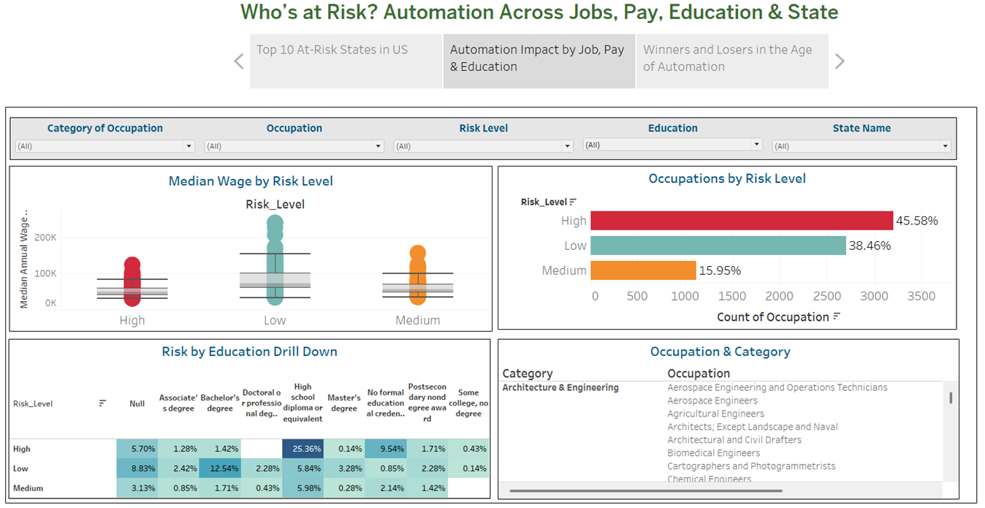
Risk by Income, Education, & Occupation
Income: High-risk jobs are concentrated in lower wage brackets; low-risk jobs cluster around higher incomes.
Education: Most high-risk jobs require only a high school diploma or less, whereas low-risk occupations often demand college degrees.
Occupations: Nearly 46% of job types fall into the high-risk category, indicating broad exposure across sectors.
Insight: Education and income are key buffers against automation’s impact.
Notes:
Who Is Most at Risk?

Slide 15
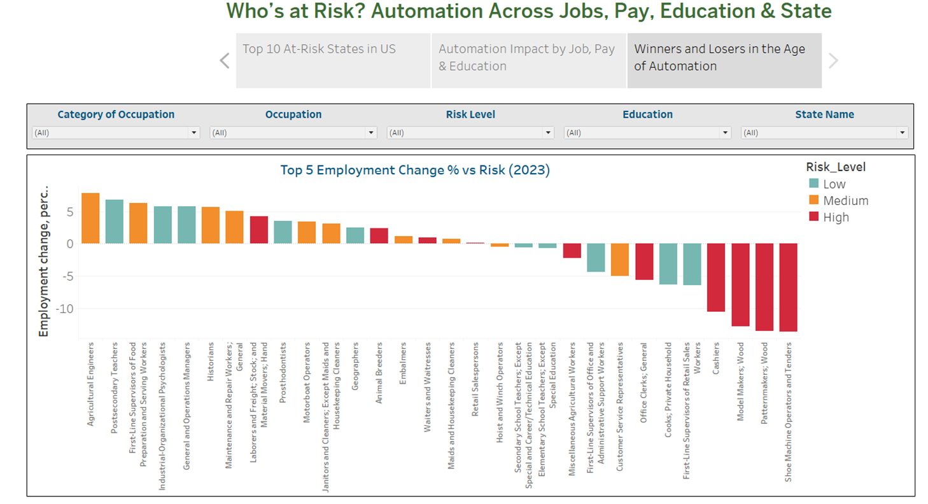
Employment Growth vs. Risk
Some occupations like agricultural engineers and educators are growing despite automation, showing resilience.
In contrast, cashiers, retail workers, and machine operators are experiencing significant decline.
Most high-risk roles are seeing negative growth, highlighting the urgency of retraining and workforce transition.
This chart shows the diverging paths of jobs based on automation exposure.
Notes:
Jobs Gaining or Losing Ground in the Age of Automation

Slide 16
Key Findings
States like California and Texas have the most jobs at risk due to their large job markets.
Lower-paying jobs are more likely to be replaced by automation.
People with less education (like only a high school diploma) are in higher-risk jobs.
High-risk jobs such as cashiers and machine operators are shrinking in number.
Nearly half of all jobs fall into the high-risk category, showing wide impact.

Slide 17
Conclusion & Recommendations
Limitations & Considerations
Risk estimates are probabilistic, not guarantees; tasks may evolve
Employment trends may shift due to unexpected technological or economic changes
No coverage of gig economy or hybrid roles
Data may underrepresent newer AI-resilient jobs
Reskilling and lifelong learning must be prioritized
Automation risk is tied to geographic, educational, and economic disparities
Policy should support vulnerable sectors with upskilling
Future studies could expand to global sectors
Interactive tools enable better stakeholder engagement

Slide 18

Thank you for listening

